Slide 1
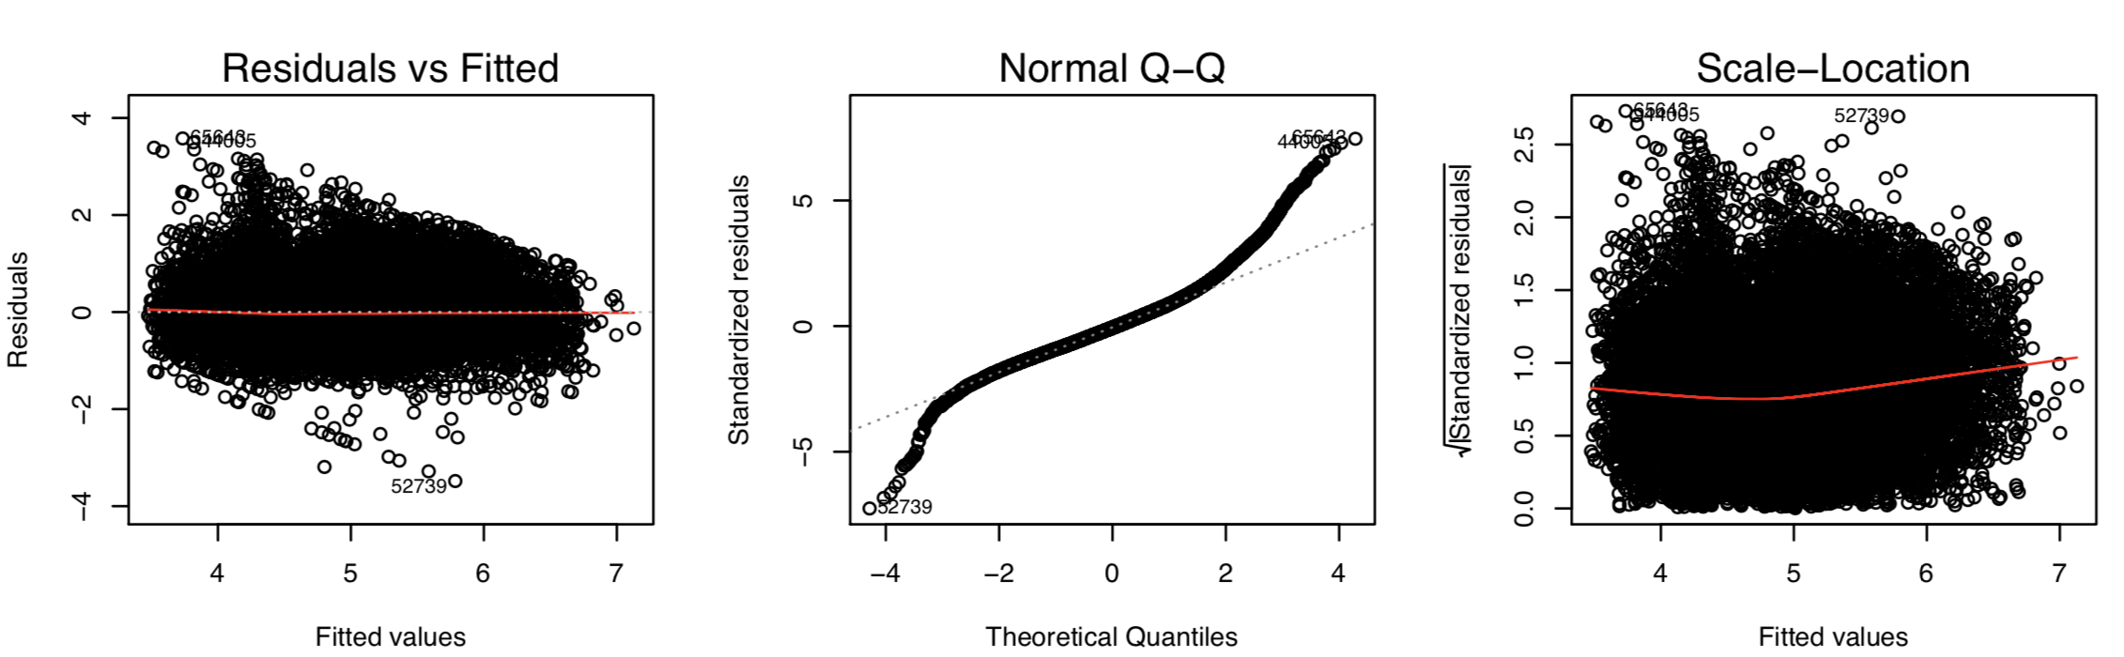
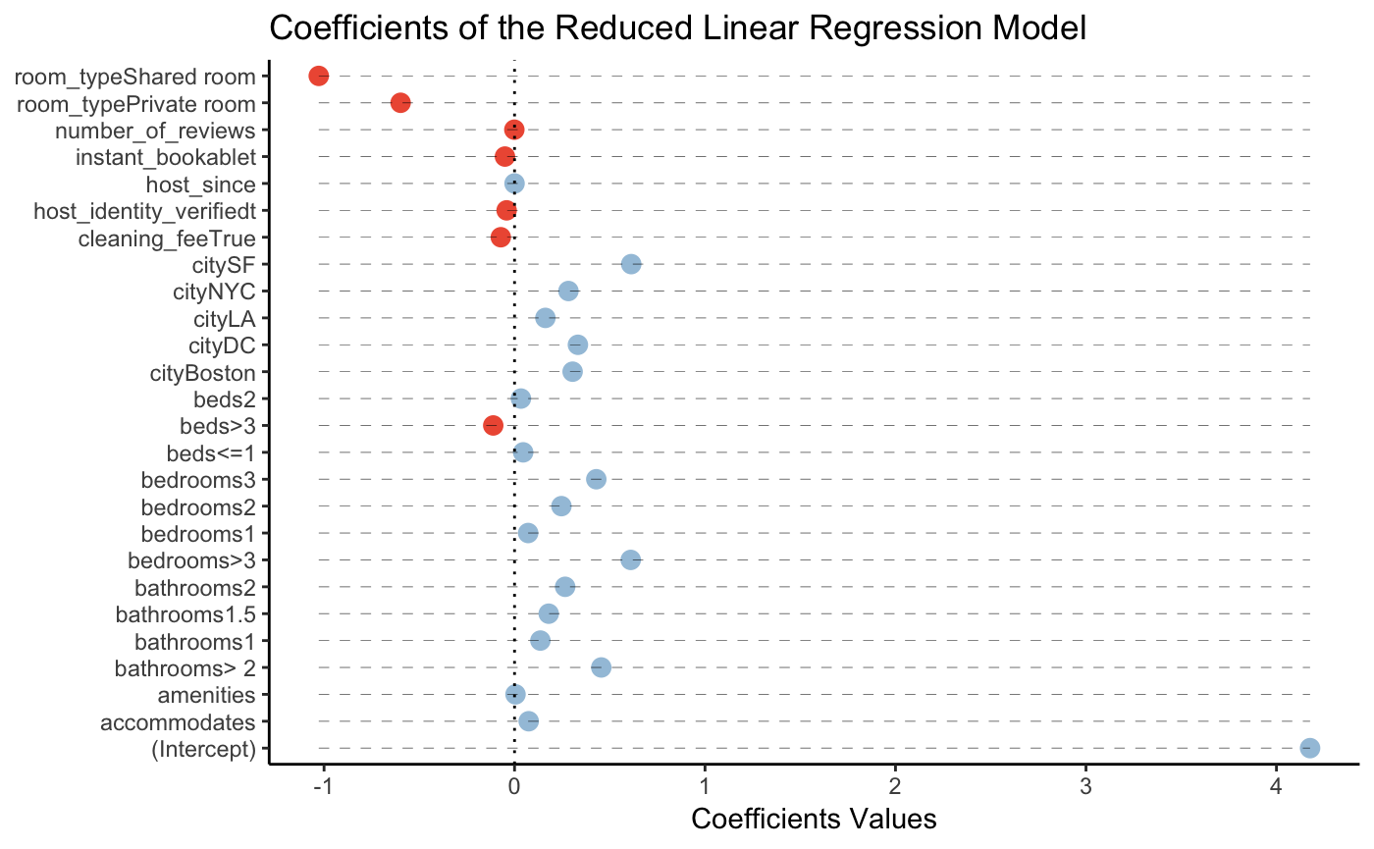
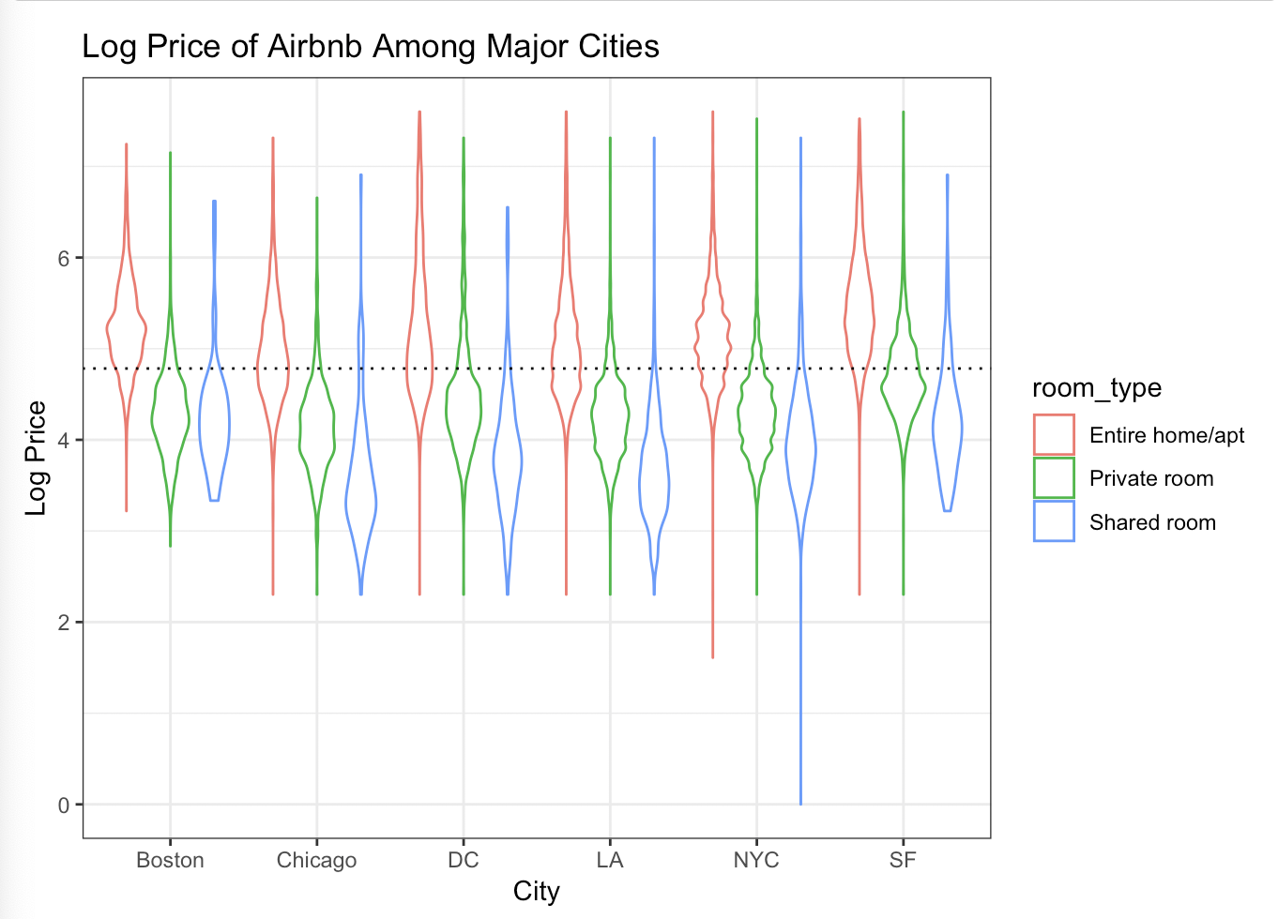
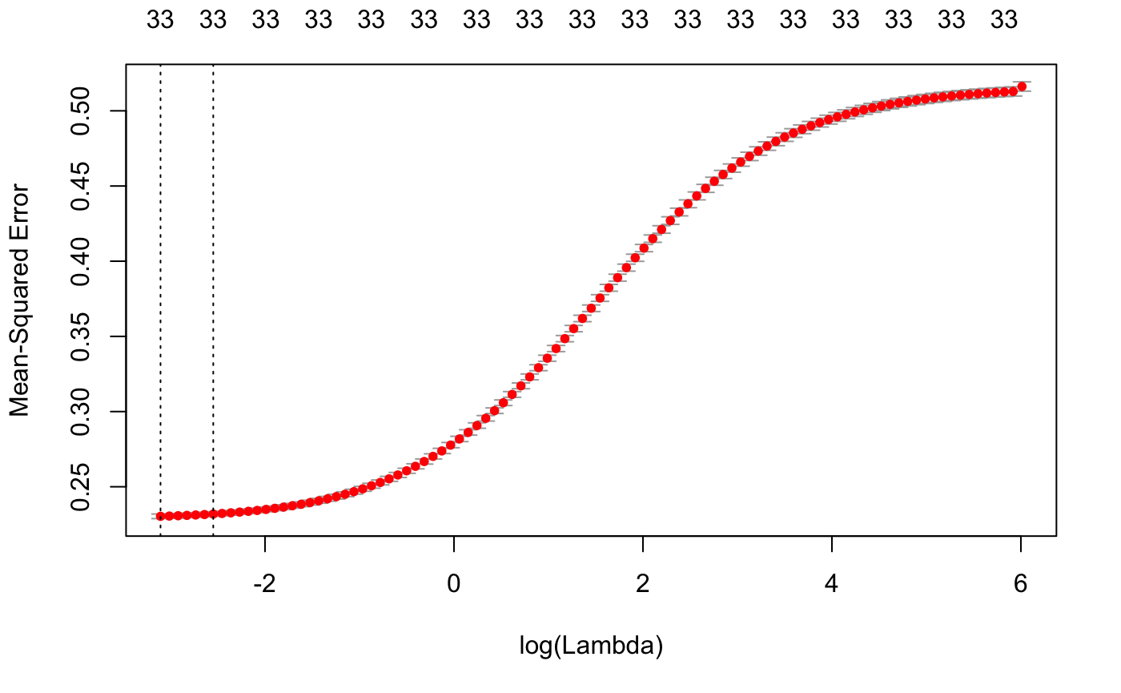
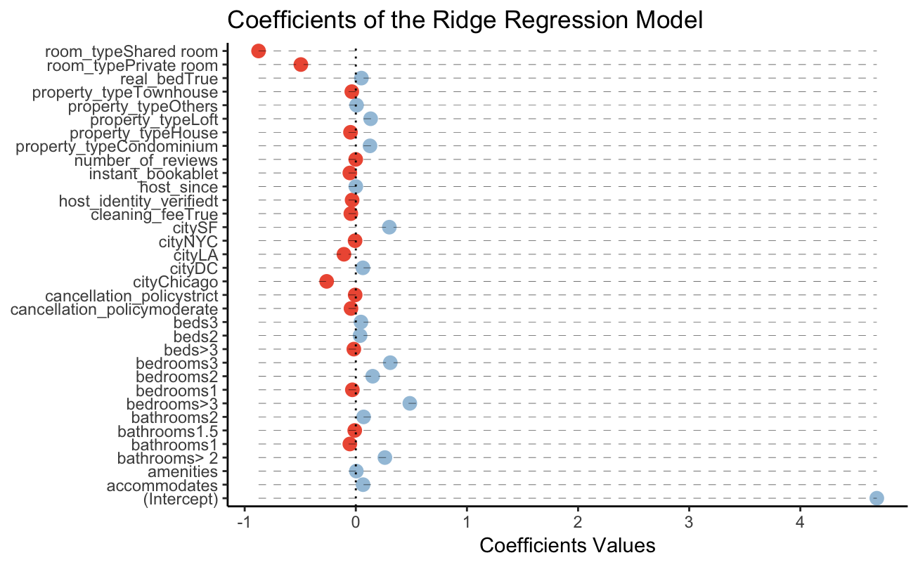
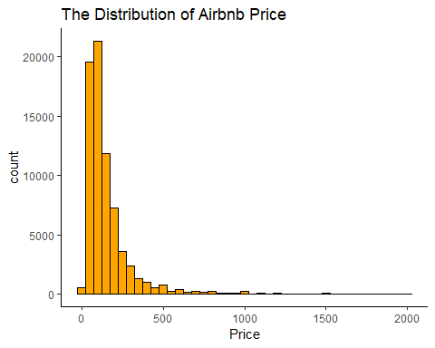
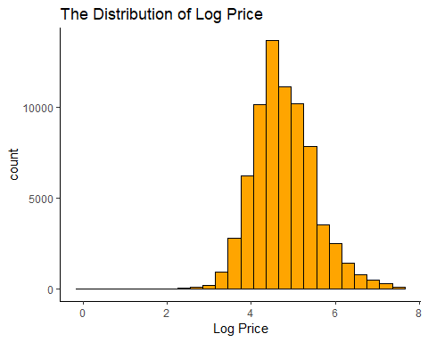
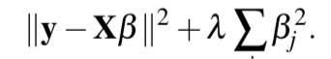
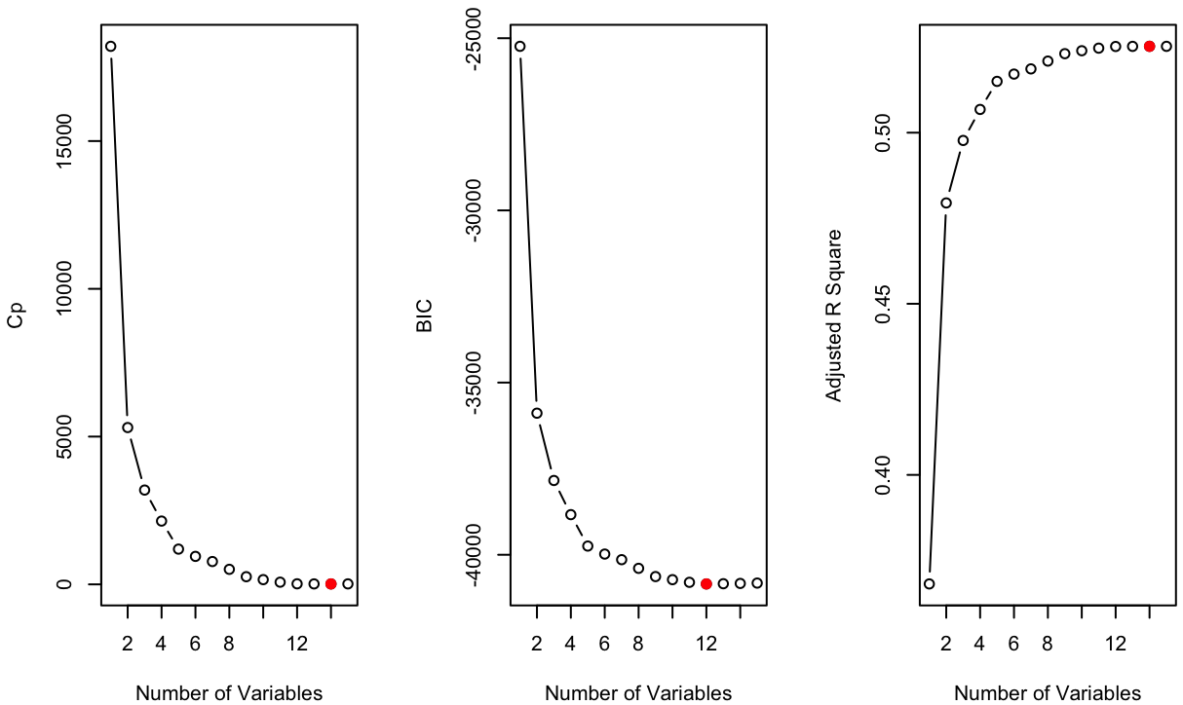
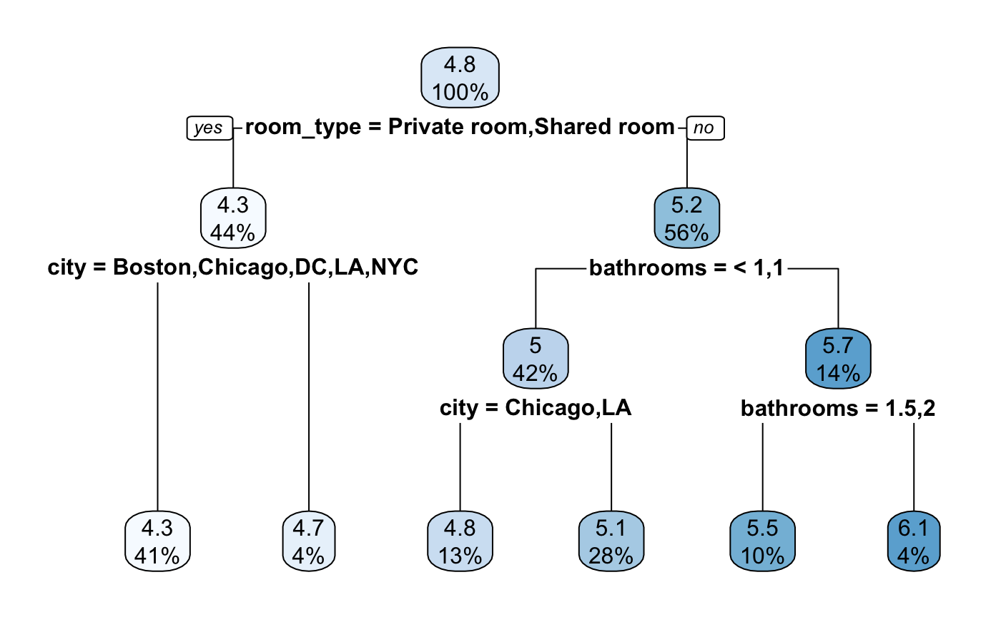
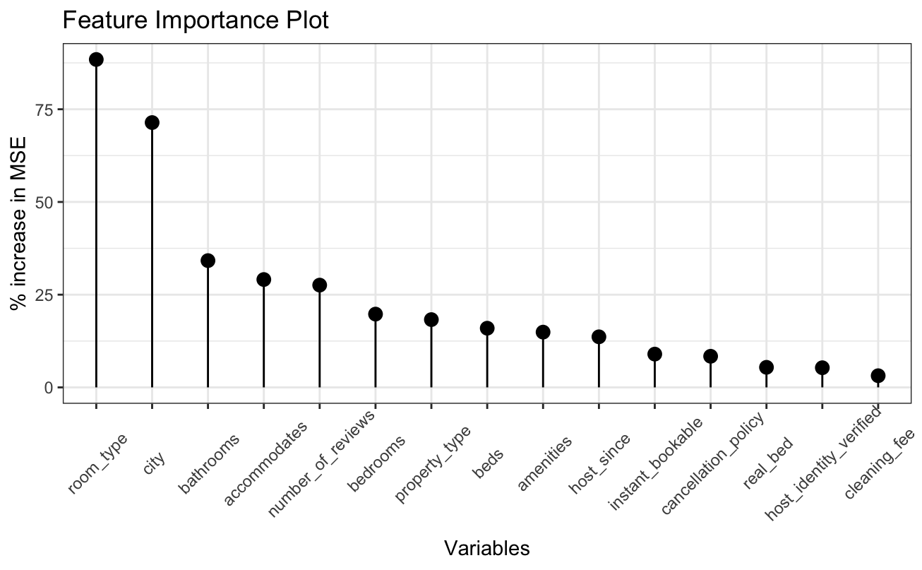
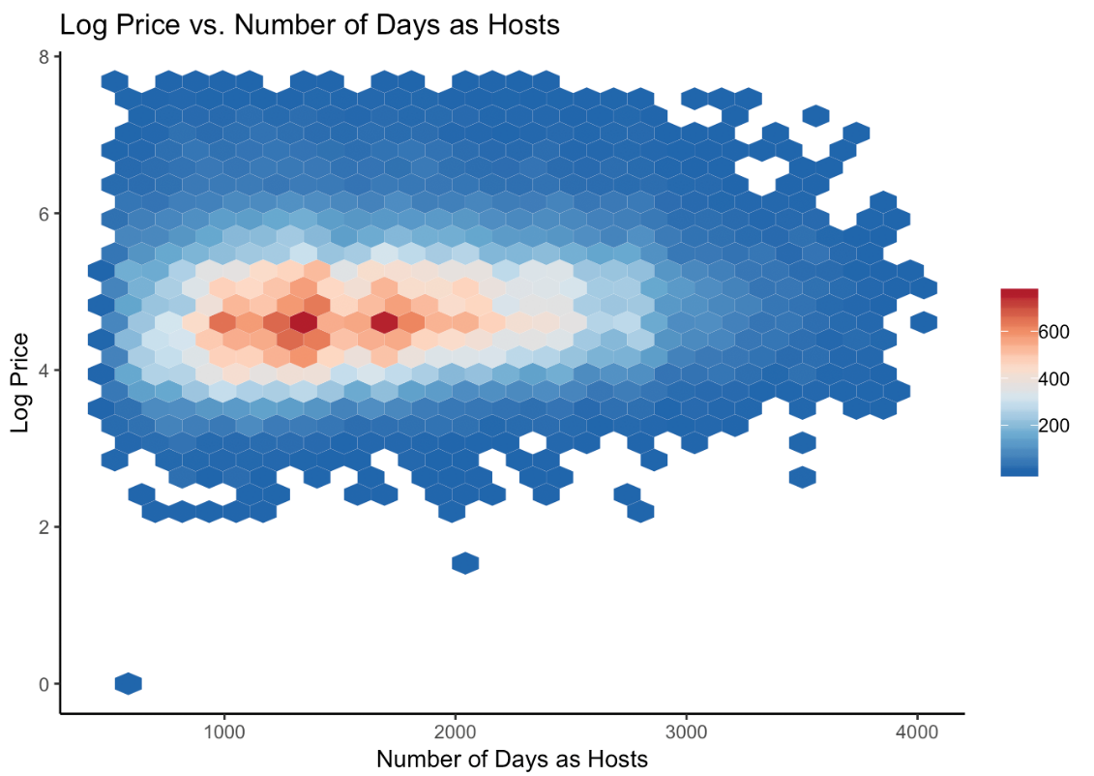
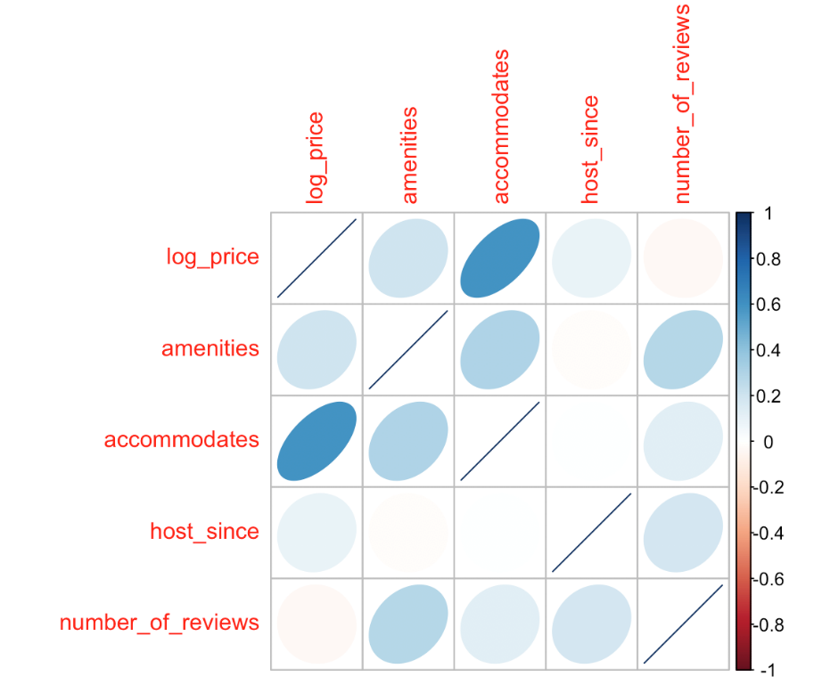



Predicting prices for Airbnb Shuhan Xia¹, Netra Pathak² , Ashwin Tarikere³ ¹Department of Statistics, ²Information School, ³Department of Mathematics, University of Washington, Seattle
Motivation
From left plot, we see an outlier where log(price) is zero and number of days as hosts is less.
Figure 3. Violin plot for log price in 6 cities w.r.t. room type.
Figure 5. (Left): Model Diagnostics for Linear Regression Model Assumptions(Right); Plot for coefficients of the Reduced Linear Regression Model
The market price for a rental is influenced by hundreds of attributes, ranging from location, property features to length of stay and time of the year. Extensive market research helps to determine the price of each listing. Airbnb designed a tool that could suggest prices to hosts on the website. As a first step, it would be useful to find out what are the most important features that determine the price.
Our Goal: To design a regression model for the price of Airbnb listings, isolate the most important predictors and evaluate the performance of the model.
Assumptions of constant variance, zero mean are satisfied. Residuals are not nearly normal as the Normal Q-Q plot is heavy-tailed. Normality assumption may be violated.
The Data
We obtained the dataset from Kaggle.
Over 70,000 observations
27 predictors from six major US cities:
We split the dataset in random into two parts: one for training the model and the other to test its performance.
Figure 1. The distribution of list prices was heavily right skewed. So we transformed to the logarithm of the price as the response variable.
Ridge Regression Model
Figure 6. (Left): Model Diagnostics for Ridge Regression Model Assumptions(Right); Plot for coefficients of the Ridge Regression Model using
$λ.$1se
We see that:
Across 6 cities, entire home/apt. price is high compared to private room and shared room.
Overall, San Francisco has the highest prices among the 6 cities
A regularization method that adds penalty term, thus doesn’t need model selection
used for model because it corresponds to most regularized model and still have low MSE (little higher than ).
$λ.$1se
Methods
Linear Regression Model
$$λ.min$$
Figure 4. Variable Selection Plot using Forward Stepwise Approach, based on 3 criteria: C_{p}, BIC, Adjusted R²
Ridge regression coefficient estimates minimize:
Pre-processing:
We dropped predictors that are hard to quantify (like property description) or had too many NA values.
Dropped all location variables other than city name.
Reduced the number of levels for categorical predictors by combining closely related factor levels with less data points into one (ex: by subsuming “super strict” cancellation policies into the strict category).
Regression Tree Model
Random Forest Model
Non-parametric, works top-down, chooses a variable at each step that best explains log price.
Building a multitude of decision trees through bootstrap method
Pick features by random to avoid high correlated predictions
Future Work
Lasso is not adopted for the project, because it will shrink the model by letting coefficients of some levels of a categorical predictor to be exactly 0, but treating one factor as a whole is preferred.
To avoid this, we can further perform and analyze Elastic Net and Group Lasso regression.
Figure 7. Tree Plot for the Regression Tree Model
Figure 8. Variable Importance Plot Based on Random Forest Model
Exploratory Data Analysis
Figure 2. (Left) Heat Map of Log Price vs. Number of Days as Hosts, maximum points are concentrated near center; (Right) Correlation Matrix for the numerical variables in the processes dataset.
Based on BIC exclude: real_bed
C_{p} and Adjusted R²: real_bed, property_type; cancellation_policy
Results
Test error for each model:
Linear Regression:
full model: 0.2263
reduced model: 0.2282
Ridge Regression: 0.2292
Regression Tree: 0.2578
Random Forest: 0.2039
We compared 2 linear models:
Full model with 14 predictors excluding only real_bed
Reduced model with 12 predictors excluding 3 predictors
There is only trivial improvement in model fitting. Hence, we use reduced model with 12 predictors.
References and Related Work
Wang and Nicolau, “Price determinants of sharing economy based accommodation rental: A study of listings from 33 cities on Airbnb.com”, Int. J. Hospitality Management, 2017.
Hill, “How much is your spare room worth?”, IEEE Spectrum, 2015.

